Slide 1
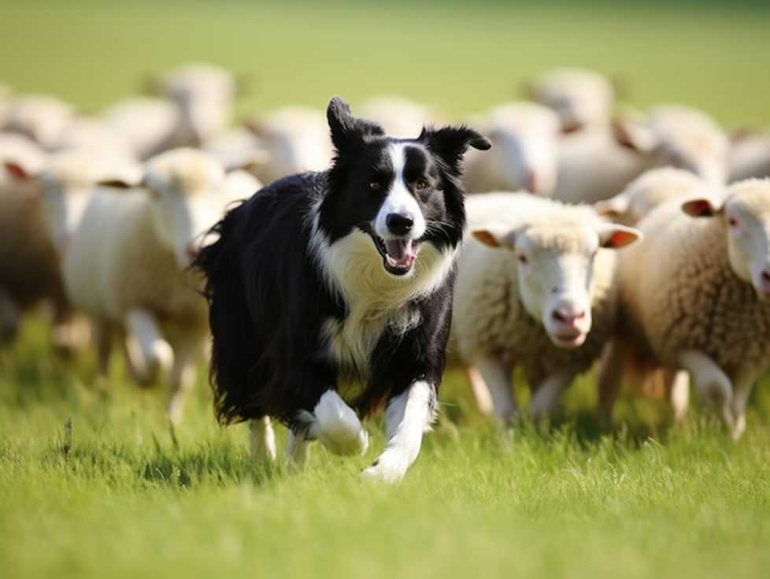
UL FRI
Collective Behaviour
Sheepdog-Driven Algorithm for
Sheep Herd Transport
Idora Ban
Simon Hehnen
Iva Idzojtic
Lucas Pucher

Slide 2
Overview
Motivation
Goal
What did we do?
Algorithm
Implemantation (+ Obstacles)
Visualization
Our results
What would we do differently?

Slide 3
Motivation
Models real-life herding behaviour
Improves group control in a dynamic environment
Scalable for various different group sizes and terrains
Applicable in robotics, crowd managament, logistics

Slide 4
Goal
Replicate and evaluate the
Sheepdog-Driven Algorithm by Liu et al. (2021)
Visualize the results

Slide 5
What did we do?

Slide 6
Algorithm
Sheepdog as Controller:
Acts as the primary entity guiding the sheep
Sheep as Agents:
Each sheep moves autonomously in reaction to the environment
Sheepfold with Radius as Target Area:
The goal is for all sheep to move into the defined destination area

Slide 7
Algorithm
Movement Logic:
At each step, the sheepdog's velocity vector is computed based on its position relative to the destination and the sheep
Each sheep's velocity vector is determined by its reaction to the sheepdog's position and the positions of nearby sheep
Termination Condition:
The algorithm concludes when all sheep are inside the target area

Slide 8
Key hyperparameters
Initial positions
sheepdog
sheep
target
Vision radius of the sheepdog
Safety radius for sheep
Destination radius
Radius of attraction

Slide 9
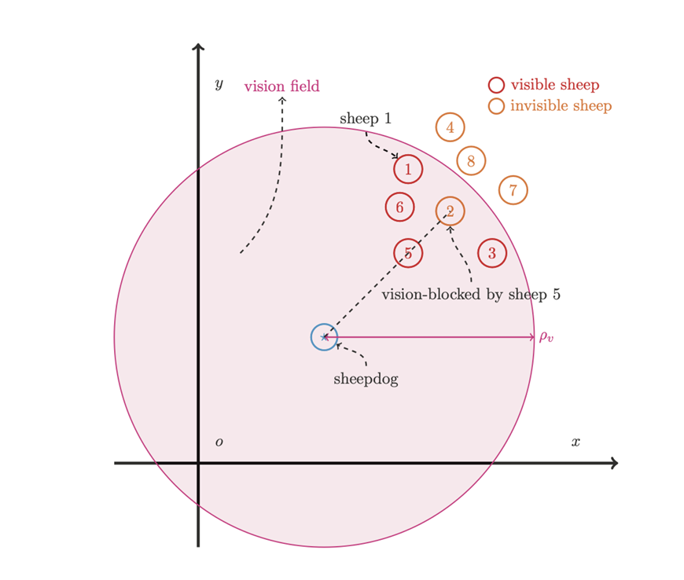

Slide 10
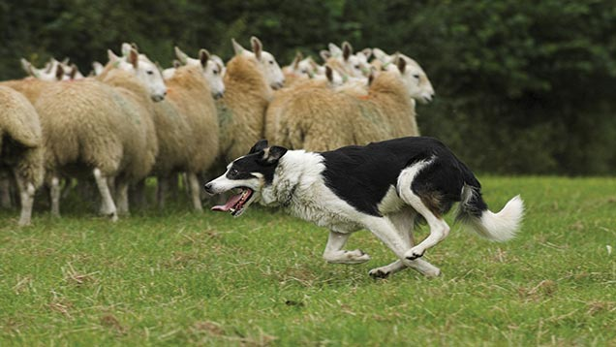
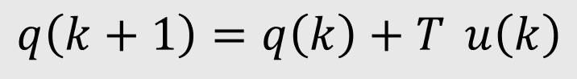
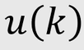
Sheepdog’s velocity
The velocity vector is calculated by determining whether the sheepdog is on the left or right side of the sheep relative to the target
The leftmost and rightmost sheep also influence the sheepdog's movement (to aid in collecting straggling sheep)
Important: Not all sheep are visible to sheepdog, some may be occluded due to vision blocks

Slide 11
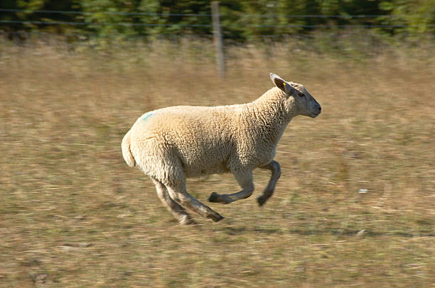
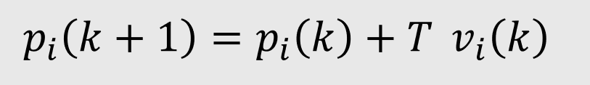
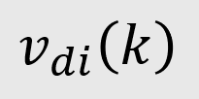
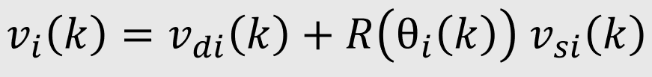
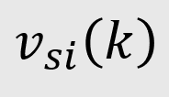
Sheep’s velocity
Reaction to sheepdog
Reaction to other sheep

Slide 12
Implementation
no open-source code from the authors
basic Python with only `numpy` and `matplotlib` libraries
the realization in a 2D coordinate system
all positions at each step are saved as a list of tuples

Slide 13
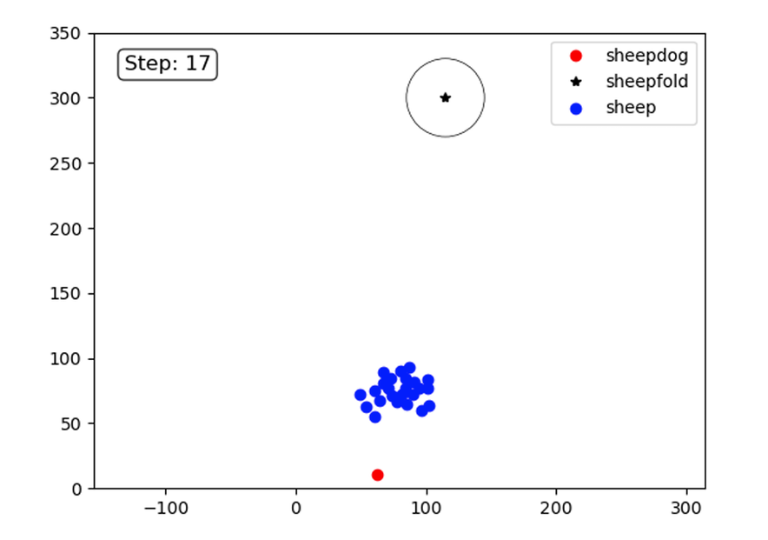
Simulation
Basic simulation for debugging purposes using `matplotlib` plots
The implementation produces good results and is well-suited for debugging

Slide 14
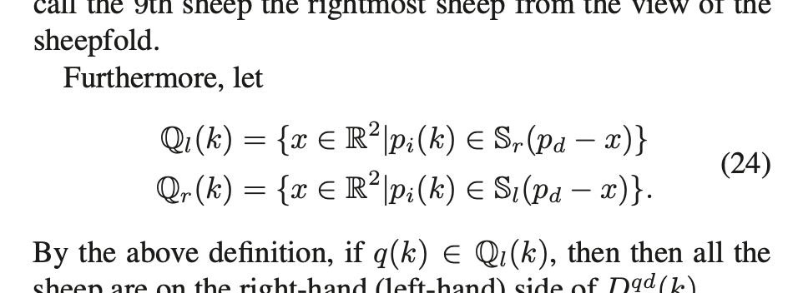
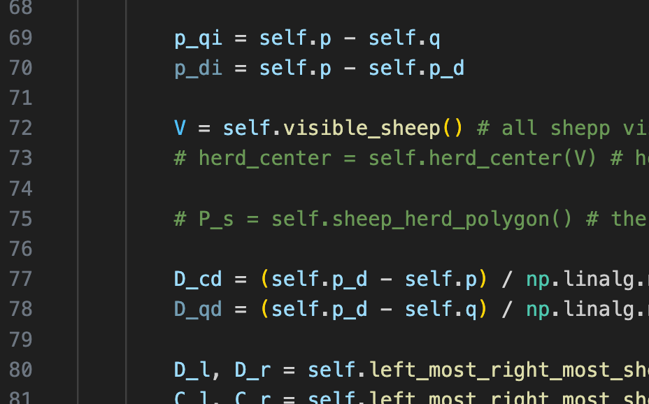
Obstacles
Paper terminology
No response from the authors
Notes:
Paper terminology
Authors didn’t respond
Fundamental knowledge

Slide 15
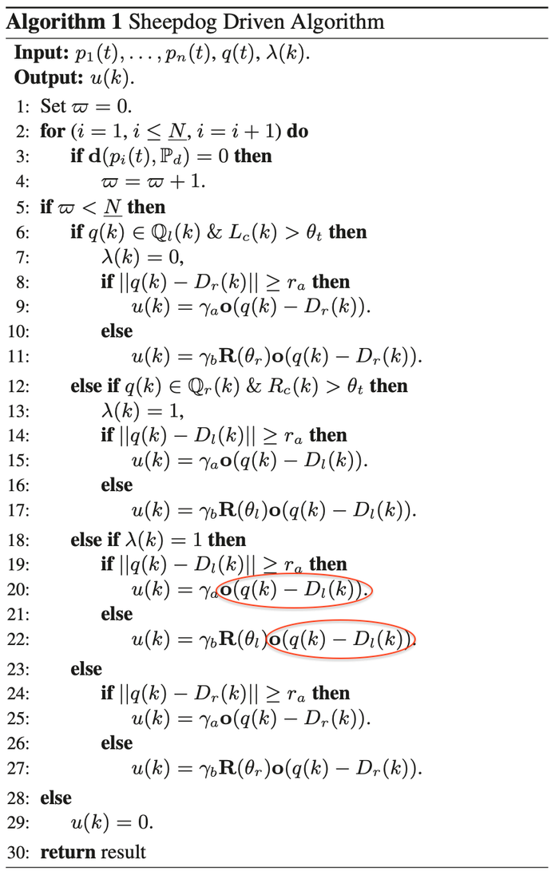
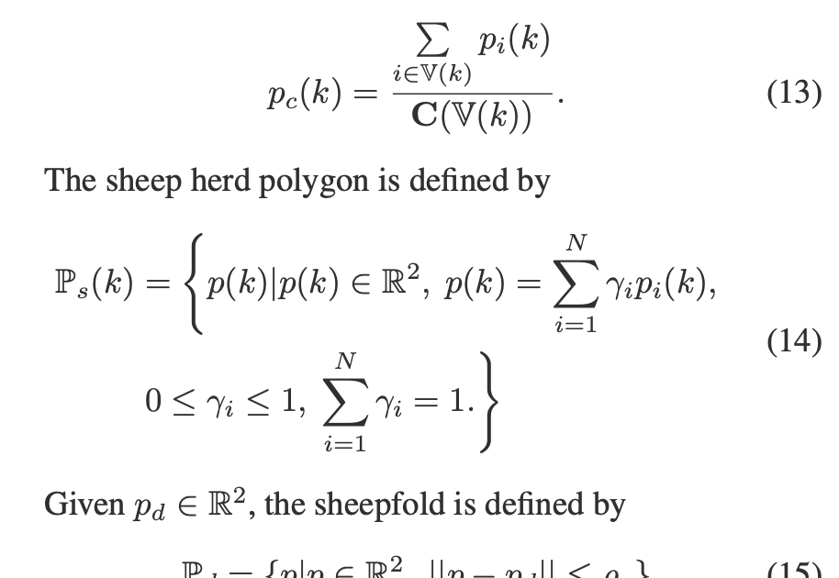

Slide 16
Visualization
Developed in Unity to render movement data from Python simulation
Goals:
Provide an intuitive, interactive environment to analyze the sheepdog-herd dynamics
Make it look more realistic
Notes:
Key Features:
Path Data Import: Movement data (.json) animated into paths for the dog and sheep.
Environment:
Realistic flat terrain with textures and a skybox (FRI campus).
Adjustable parameters for simulation speed and path visualization.
Dynamic Scene Management: Entities generated and controlled by a central "Manager" object.
3. Highlights:
Visual Cues:
Path trails, speed indicators, and field-of-view displays.
Smooth transitions for movement and rotation.
Camera Modes: Five perspectives, including top-down and sheepdog’s view

Slide 17
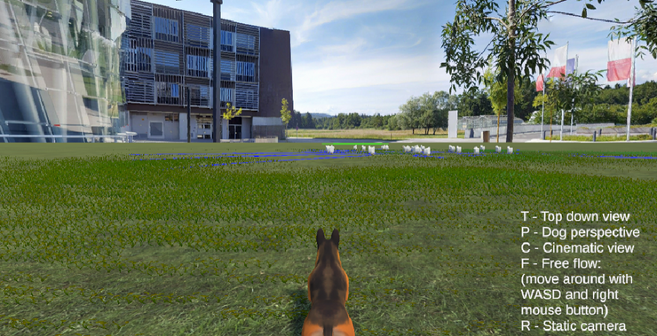
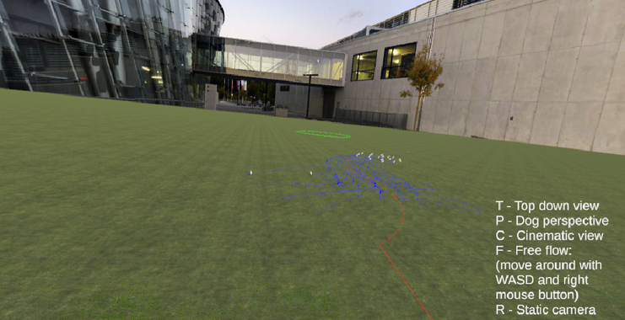
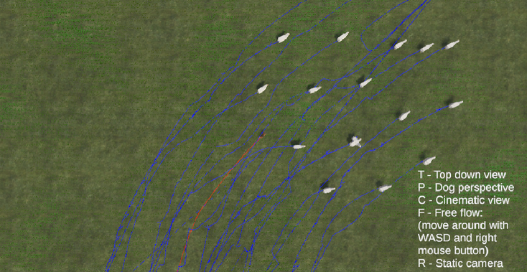
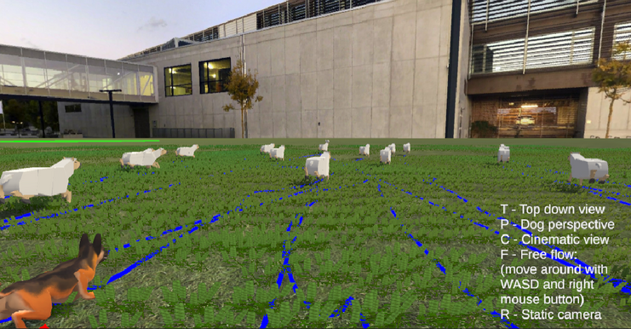
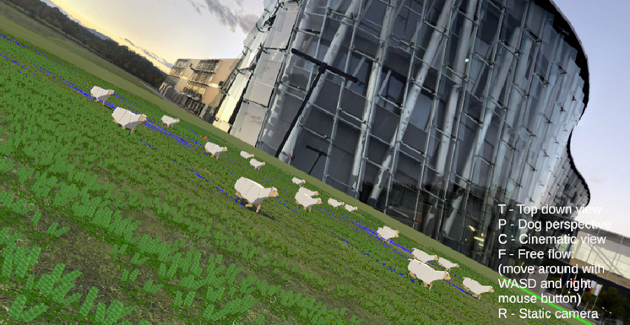
Camera modes
Dog perspective view
Static camera view
Top-down view
Cinematic view
Free-flow view

Slide 18
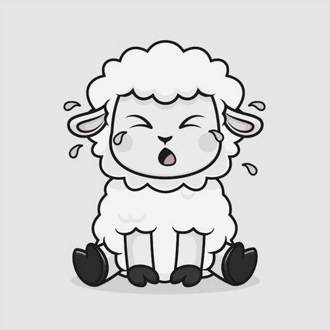


Our results
Building a framework
Simulation
Visualization
Reproducing the results from the paper
Discovering flaws in the paper

Slide 19
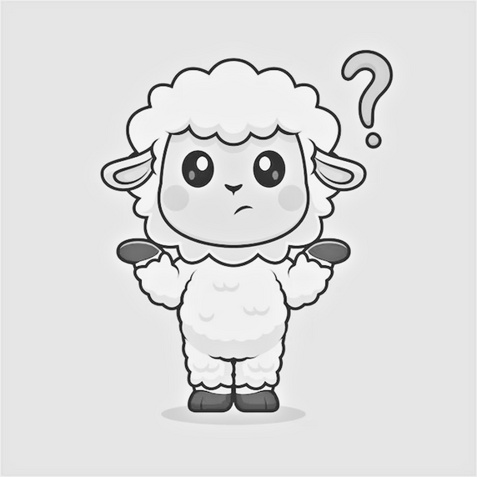
What would we do differently?
Notes:
- do more research before choosing a paper
- then maybe choose a different paper
- ask for more help instead of just trying to fight on our own
- define a team coordination

Slide 20

Thank you for your attention!

